Slide 1
Analyzing U.S. COVID-19 Data
Tasneem Muhammad 202101031
Nada Nabil 202101220
Rghda Salah 202101510
Mariam Ismael 202101506

Slide 2
Table of contents
01
02
03
Introduction
Exploratory Data
Answering Questions
04
05
06
Hypothesis Testing
Regression
Machine Learning classifier

Slide 3
01
Introduction

Slide 4
Introduction
The project is focused on analyzing COVID-19 cases using relevant datasets.
The primary objective of the analysis is to examine various aspects of COVID-19 cases and extract valuable information from the datasets.

Slide 5
02
Exploratory Analysis

Slide 6
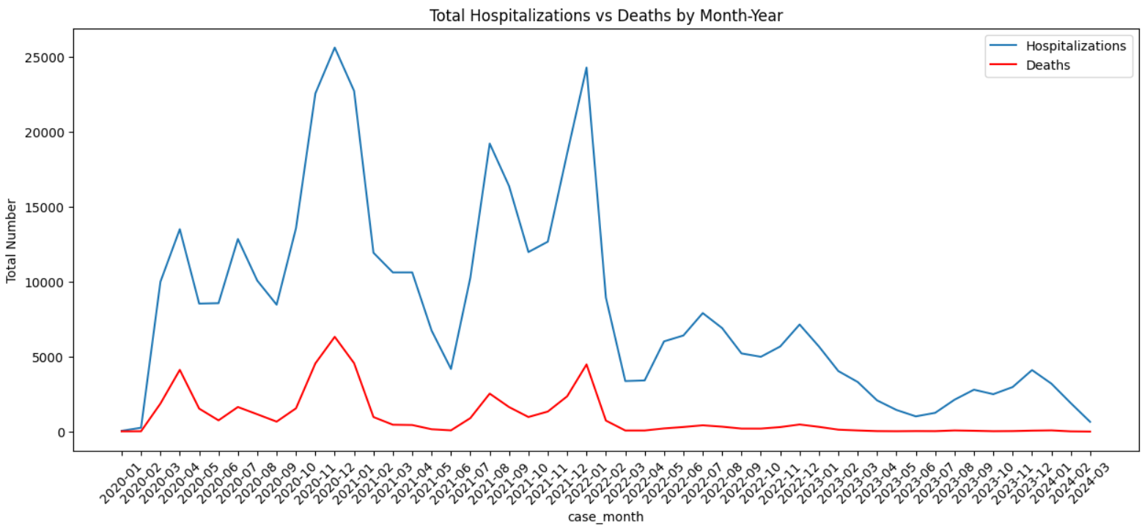
2.1 Total number of hospitalizations versus deaths from COVID-19
over the entire US per month-year timestamp

Slide 7
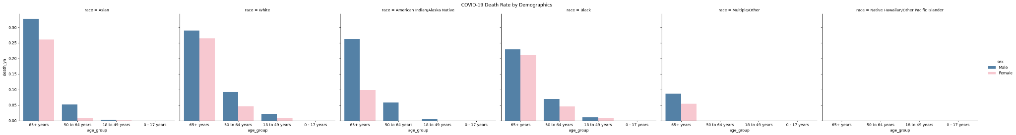
2.2 The average rates of COVID-related deaths relative to patient
demographics

Slide 8
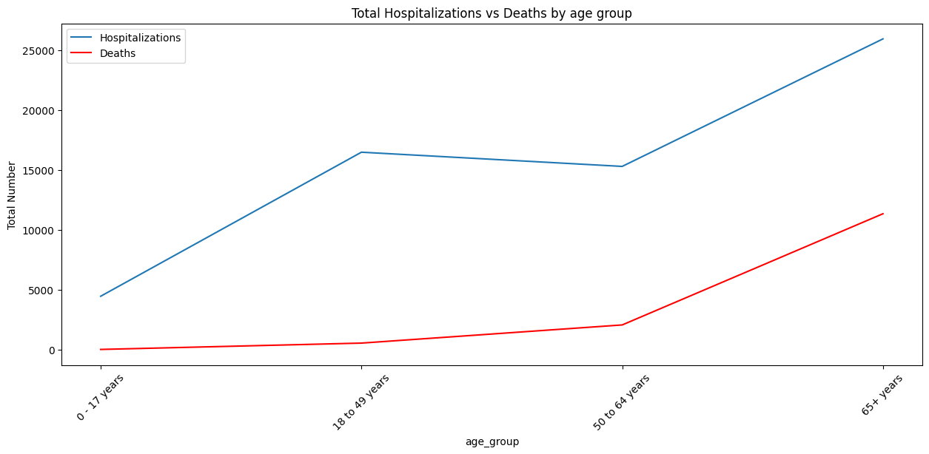
2.3 The rates of COVID-related hospitalization and death with age

Slide 9
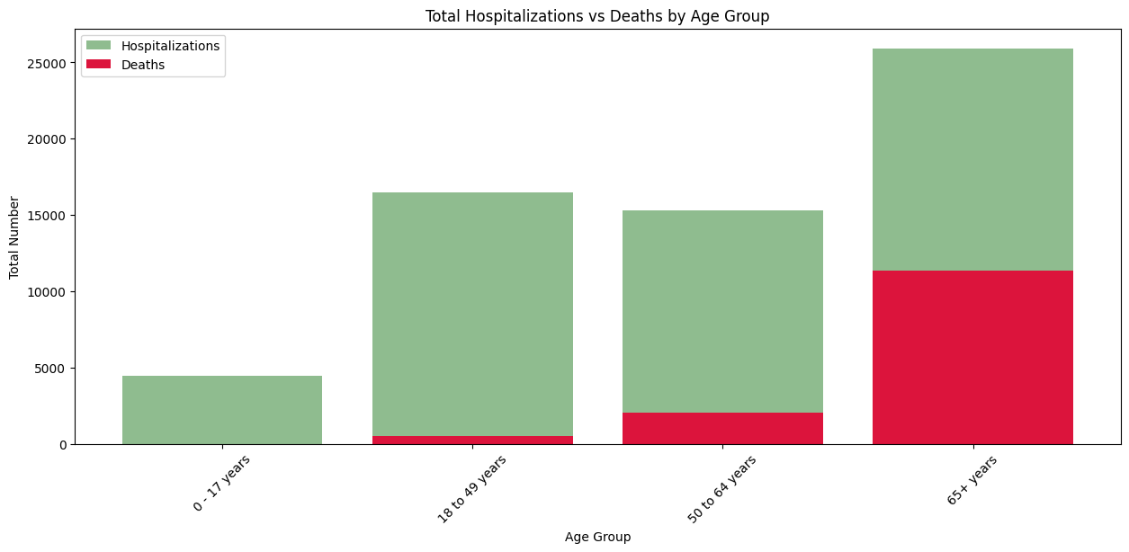
2.3 The rates of COVID-related hospitalization and death with age

Slide 10
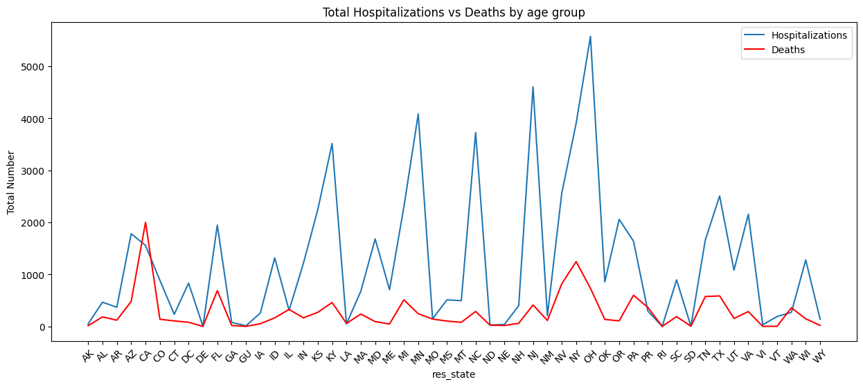
2.4 Average rate of COVID-related hospitalization and death per
state over the entire study period.

Slide 11
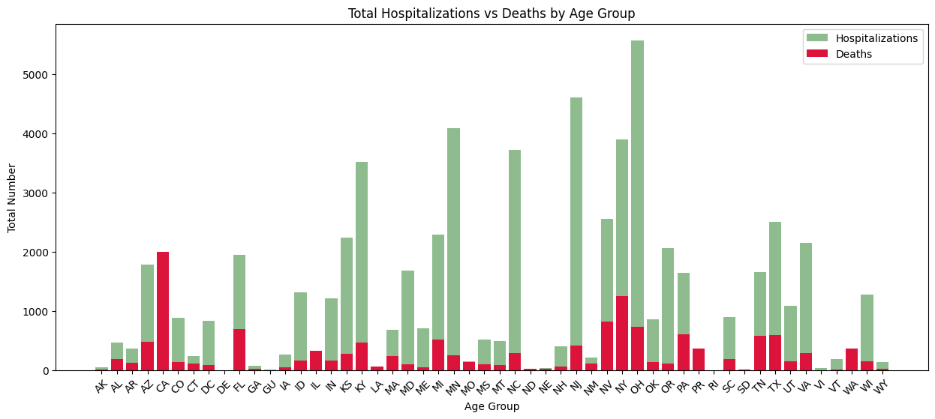
2.4 Average rate of COVID-related hospitalization and death per
state over the entire study period.

Slide 12
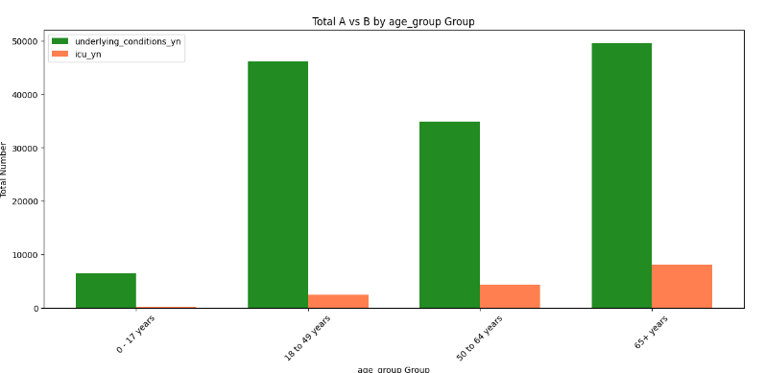
2.5 The relationship between age, pre-existing medical conditions
and/or risk behaviors, and rate of admittance to the ICU.

Slide 13
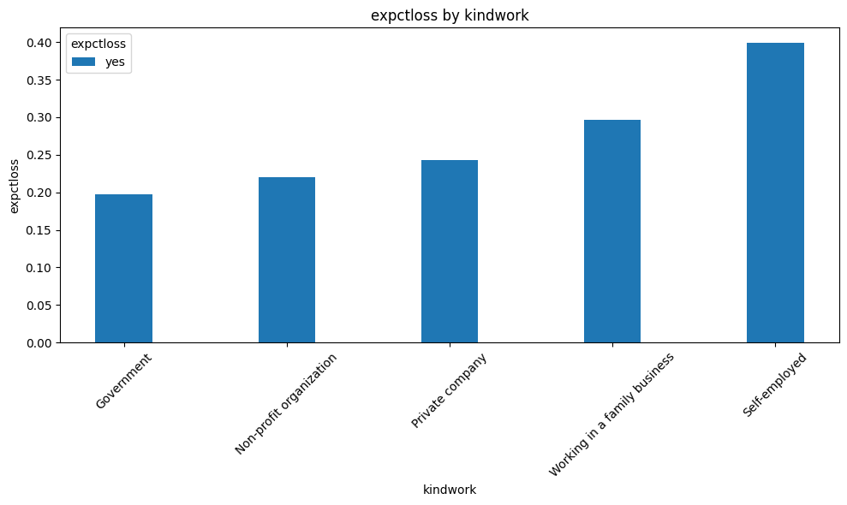
2.6 The rate of expected employment loss due to COVID-19 and
sector of employment.

Slide 14
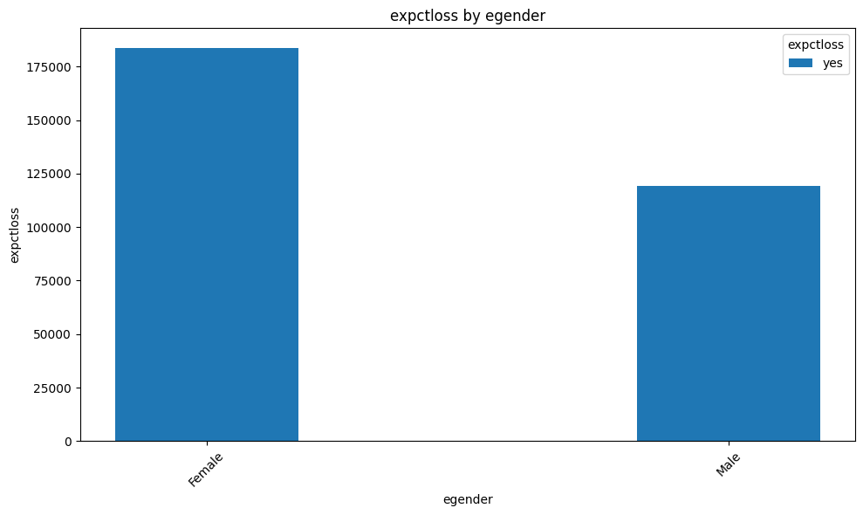
2.7 The rate of expected employment loss due to COVID-19 relative
to respondents demographics.

Slide 15
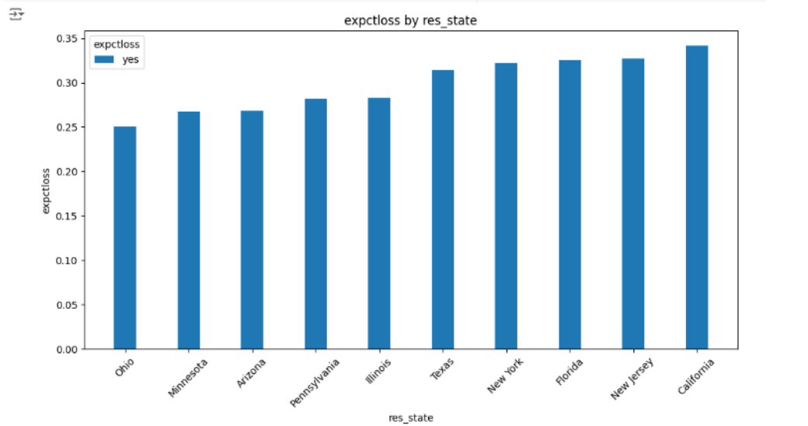
2.8 The rate of expected employment loss due to COVID-19 for the
top 10 states with the highest rate of COVID hospitalization

Slide 16
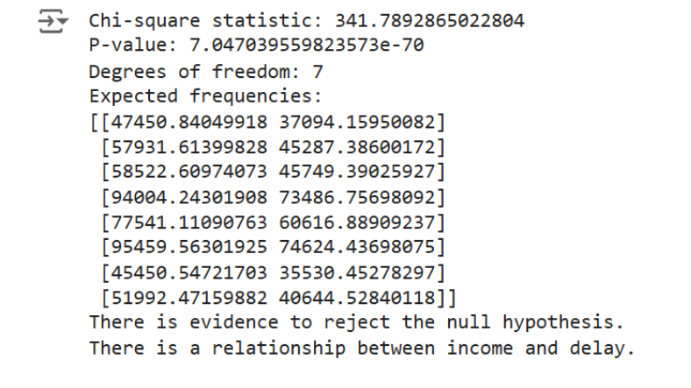
2.9 The relationship between household income and the rate of de-
layed/ OR unobtained medical treatment (Due to COVID or
otherwise).

Slide 17
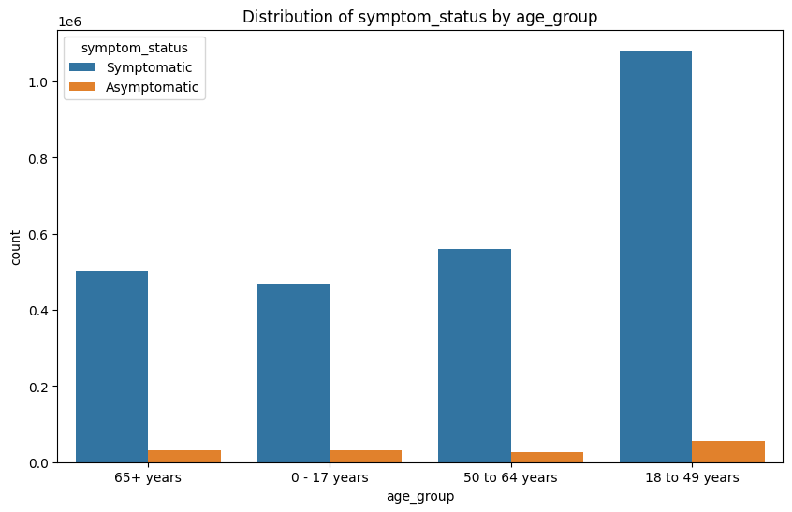
2.10 The relationship between COVID-19 symptom manifestation
and age group.

Slide 18

03
Answering Questions

Slide 19
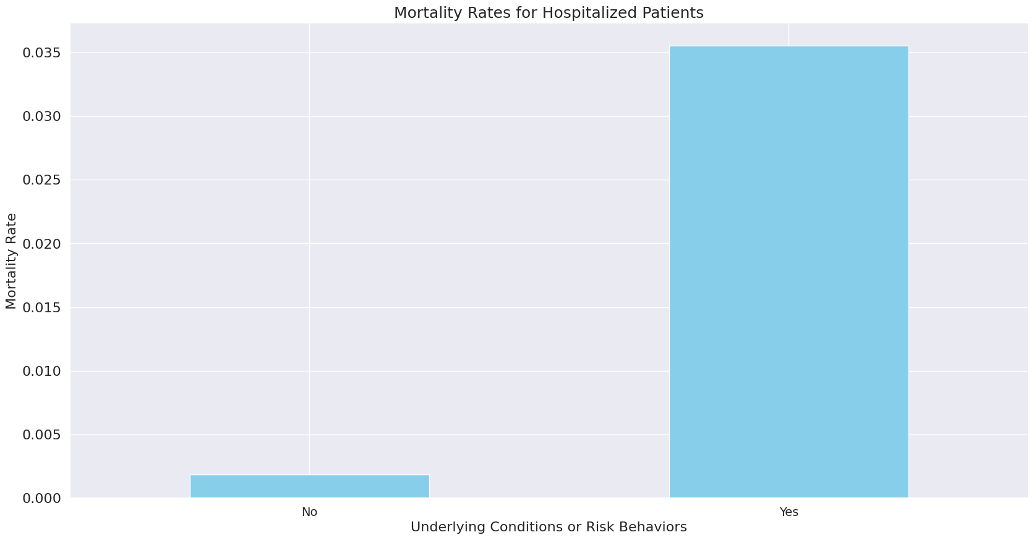
1. Are hospitalized patients with underlying medical conditions and/or risk
behaviors more likely to die from COVID-19?
Visualization

Slide 20
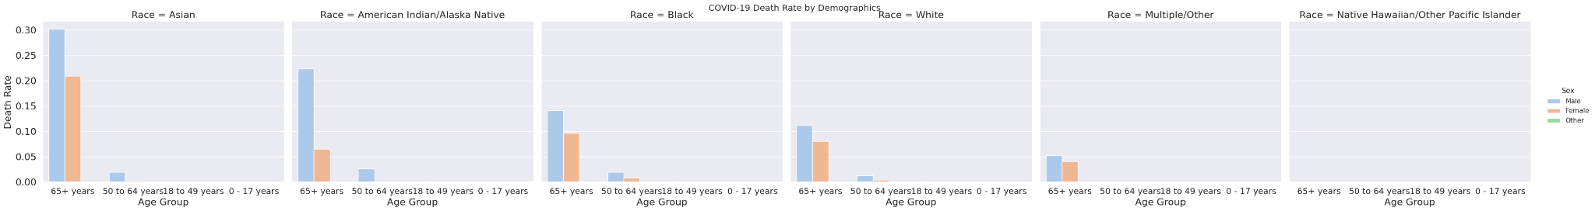
2. Are hospitalized patients with underlying medical conditions and/or risk be-
haviors more likely to die from COVID-19?

Slide 21
2. Are hospitalized patients with underlying medical conditions and/or risk be-
haviors more likely to die from COVID-19?
Commentary
Highest Risk:
Age: Older adults (65+) are most at risk, especially men with the highest rates observed in Asians (30.18%) and American Indians/Alaska Natives (22.34%). Women in these age groups also face significant mortality, particularly Asian (20.96%) and Black (9.67%) women.
Moderate Risk:
Men aged 50-64: American Indian/Alaska Native men (2.66%) and Asian/Black men (around 2%) have elevated mortality rates.
Lowest Risk:
Younger age groups (0-17): Mortality rate is 0% across races and genders.
Older women (18-49): Generally low mortality rates, highest in Black women (0.063%).

Slide 22
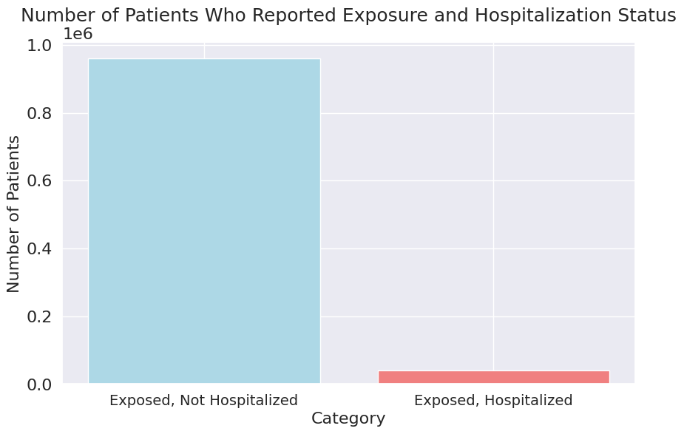
3. Are hospitalized patients with underlying medical conditions and/or risk be-
haviors more likely to die from COVID-19?
Visualization

Slide 23
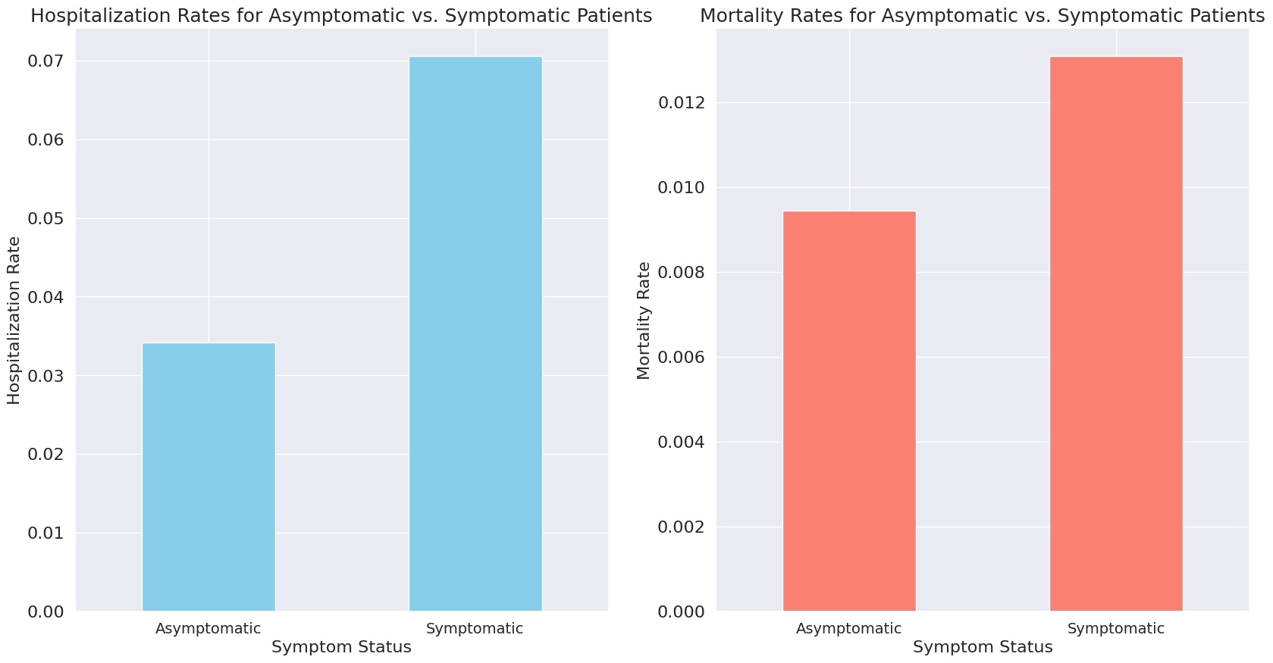
4. Are hospitalized patients with underlying medical conditions and/or risk be-
haviors more likely to die from COVID-19?
Visualization

Slide 24
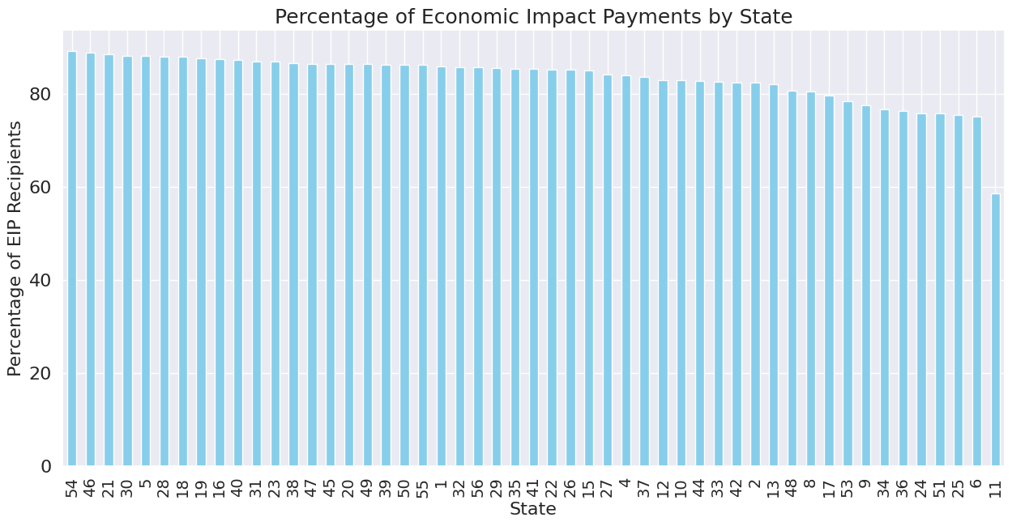
5. Are hospitalized patients with underlying medical conditions and/or risk be-
haviors more likely to die from COVID-19?
Visualization

Slide 25
5 More Questions!

Slide 26
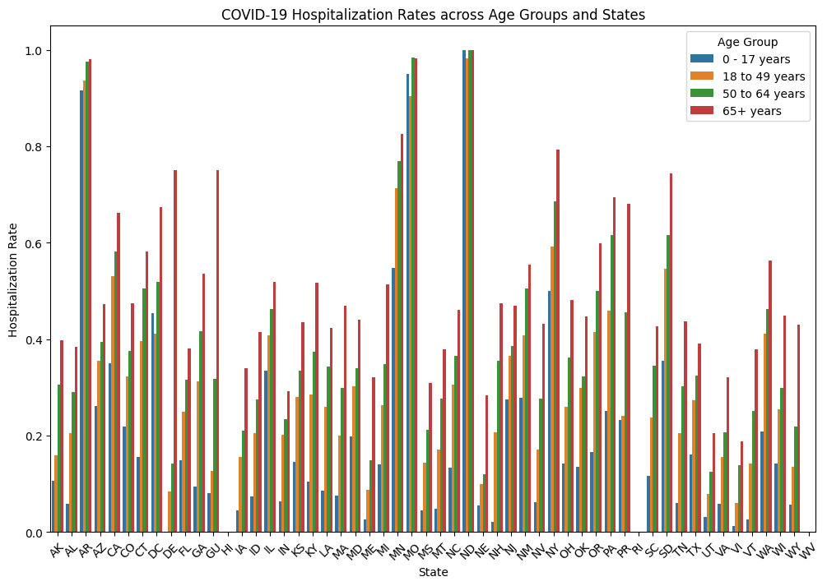
6.How does the rate of COVID-related hospitalization vary across different age
groups and states?
Visualization

Slide 27
6.How does the rate of COVID-related hospitalization vary across different age
groups and states?
Commentary
The bar graph illustrates fluctuations in hospitalization rates suggesting that the likelihood of being hospitalized varies depending on both age and location
Interpretation
State ND has the highest hospitalization rates for the all age groups :
+65 years
0 to 17 years
50 to 64 years
18 to 49 years
states HI, WV , RI has 0 hospitalization rates

Slide 28
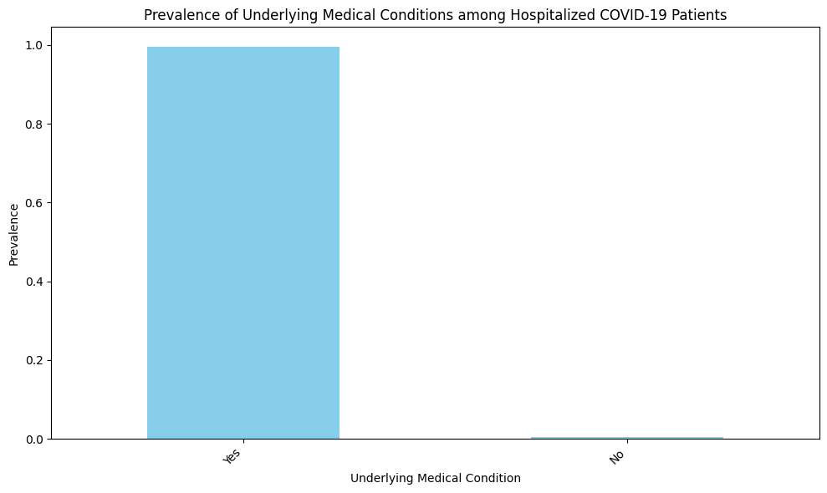
7. What are the most common risk factors associated with COVID-19-related
hospitalizations, and how do these factors vary across different age groups and
genders?
Visualization

Slide 29
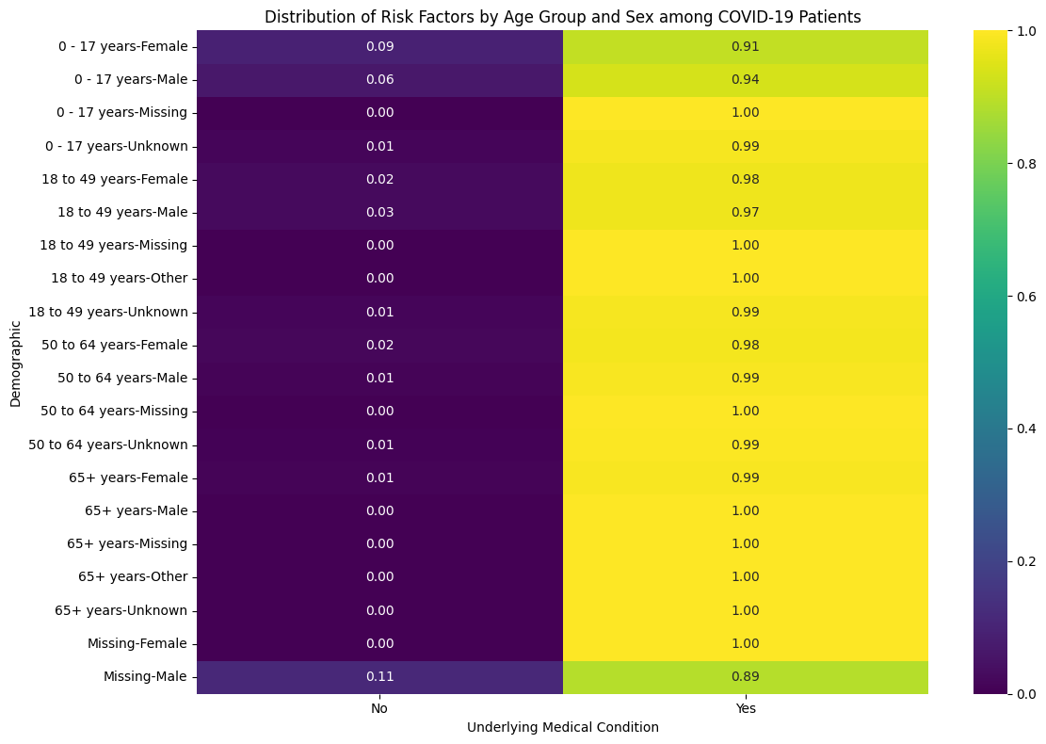
7. What are the most common risk factors associated with COVID-19-related
hospitalizations, and how do these factors vary across different age groups and
genders?
Visualization

Slide 30
7. What are the most common risk factors associated with COVID-19-related
hospitalizations, and how do these factors vary across different age groups and
genders?
Commentary
The visualization consists of a bar chart showing the frequency of existing medical conditions in hospitalized patients, and a heatmap displaying how the presence of these conditions varies across age groups and genders among the hospitalized population, with color intensity indicating the percentage of patients in each group.
Interpretation
The visualization indicates that the presence of underlying medical conditions is strongly associated with the risk of COVID-19 hospitalization, especially among older age groups. The heatmap shows that the prevalence of these conditions increases with age, with the highest rates observed in the older age brackets, highlighted by the darker colors on the heatmap.

Slide 31
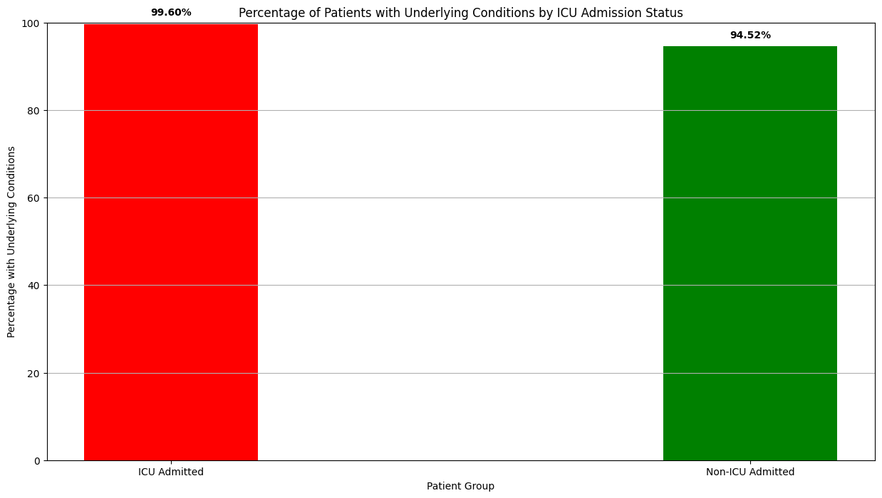
8. Are COVID-19 patients with underlying medical conditions more likely to be
admitted to the ICU compared to those without underlying conditions ?
Visualization

Slide 32
8. Are COVID-19 patients with underlying medical conditions more likely to be
admitted to the ICU compared to those without underlying conditions ?
Commentary
A study found that nearly all ICU patients with COVID-19 had pre-existing health conditions, compared to only half of non-ICU patients. This suggests a link between underlying health issues and severe COVID-19 outcomes. The results highlight the importance of prioritizing vaccination and early treatment for those with health concerns to reduce ICU admissions and improve overall outcomes.
Interpretation
The data shows a strong correlation between pre-existing health conditions and COVID-19 severity. Nearly all ICU patients (99.6%) had underlying conditions, compared to a significant portion (94.5%) of non-ICU patients.
This highlights the importance of prioritizing vaccination and early treatment for those with health concerns, potentially reducing ICU admissions and improving overall outcomes.

Slide 33
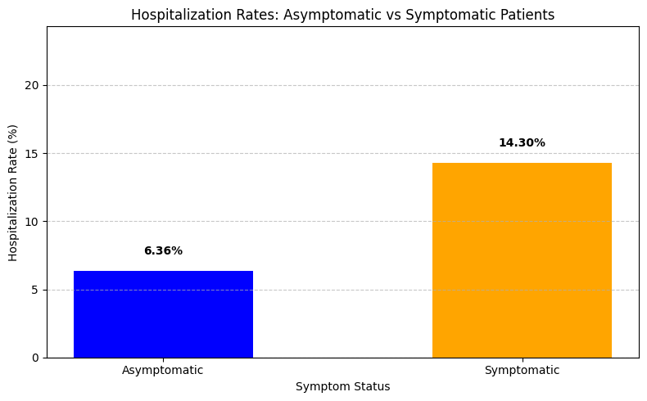
9.Do asymptomatic COVID-19 patients have lower rates of hospitalization com-
pared to symptomatic patients? How does this differ based on demographic factors
such as age and sex?
Visualization

Slide 34
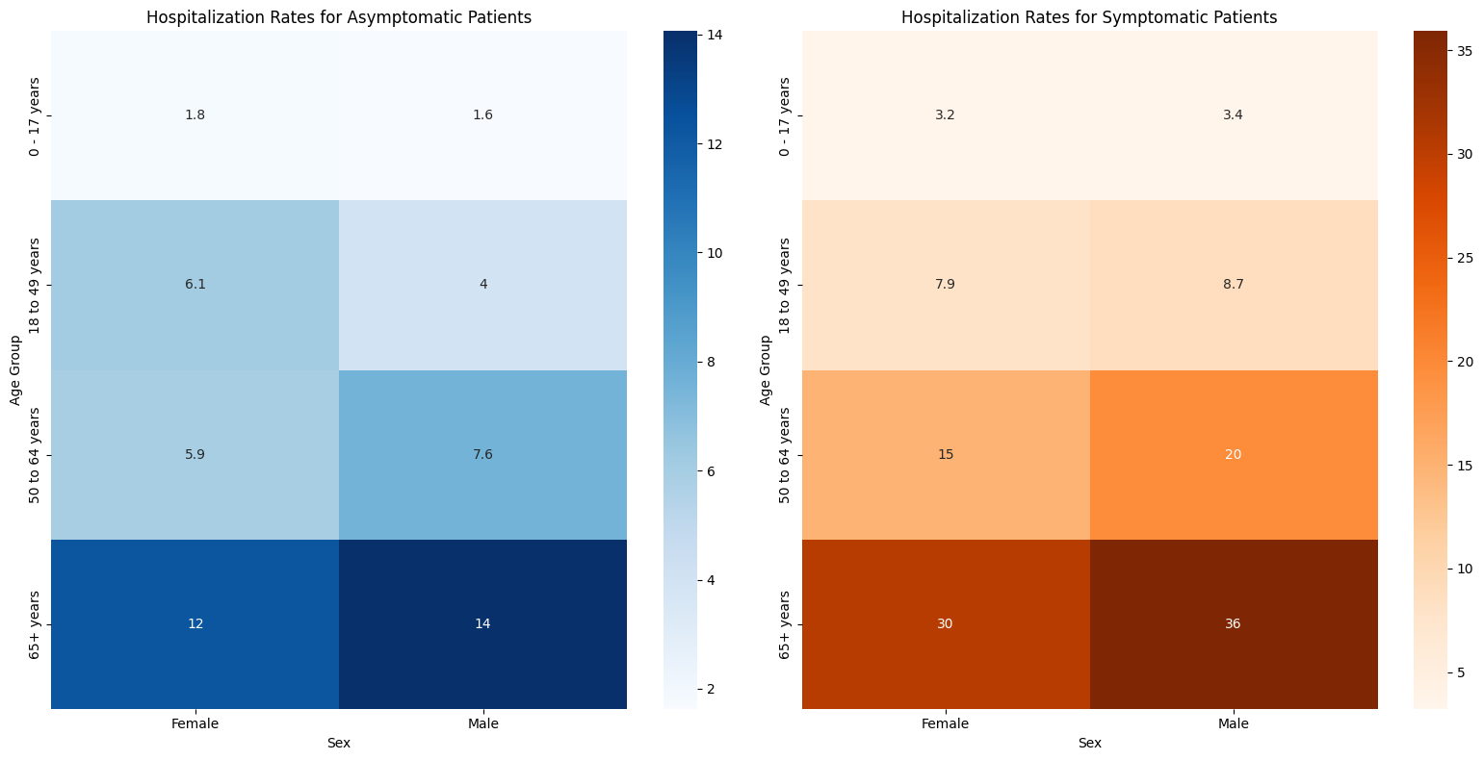
9.Do asymptomatic COVID-19 patients have lower rates of hospitalization com-
pared to symptomatic patients? How does this differ based on demographic factors
such as age and sex?
Visualization

Slide 35
9.Do asymptomatic COVID-19 patients have lower rates of hospitalization com-
pared to symptomatic patients? How does this differ based on demographic factors
such as age and sex?
Commentary
COVID-19 symptoms and older age (particularly over 65) significantly increase hospitalization risk, with males in this age group facing an even greater threat. Therefore, close monitoring of symptomatic individuals and prioritizing care for older adults and males are crucial.
Interpretation
While COVID-19 symptoms significantly increase hospitalization risk (6.36% vs 14.30%), age also plays a major role, with rates climbing steadily for both genders above 50 (reaching 12.25% for females and 14.06% for males over 65).
Males consistently have slightly higher hospitalization rates than females across all age groups.

Slide 36
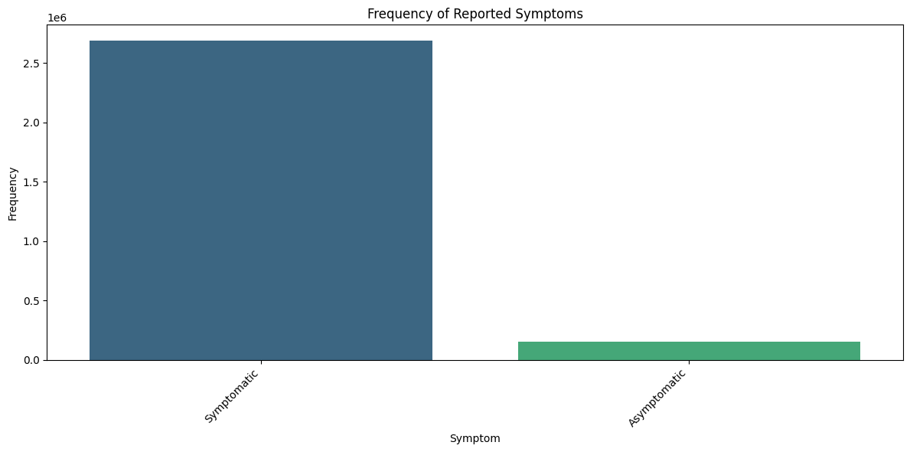
10.What is the frequency of common symptoms reported by COVID-19 patients,
and how do they vary across different age groups and genders?
Visualization

Slide 37
10.What is the frequency of common symptoms reported by COVID-19 patients,
and how do they vary across different age groups and genders?
Visualization

Slide 38
10.What is the frequency of common symptoms reported by COVID-19 patients,
and how do they vary across different age groups and genders?
Commentary
A look at COVID-19 symptoms revealed variations in their prevalence and distribution across age and gender, suggesting possible differences in symptom experience.
Interpretation
Examining COVID-19 symptoms through bar graphs reveals the most common ones, while heat maps show how these symptoms vary by age and gender, potentially indicating differences in how the virus affects various demographics.

Slide 39
04
Hypothesis Testing

Slide 40
“There is a strong association between the probability
of death due to COVID-19 and patient demographics”

Slide 41
First Test Chosen: Anova

Slide 42
Hypothesis Test
– H0: There is no association between the probability of death due to COVID-19 and
patient demographics.
– H1: There is a strong association between the probability of death due to COVID-19
and patient demographics.
Results
– F Statistic: 2823.3188114282116
– p − value : 0
Comment
Low p-value (0.0) means we reject the idea that demographics have no effect on COVID-19 death rates. In other words, there's a connection between patient characteristics and how likely they are to die from COVID-19.

Slide 43
Second Test Chosen: Chi-squared

Slide 44
Hypothesis Test
– H0: There is no association between the probability of death due to COVID-19 and
patient demographics.
– H1: There is a strong association between the probability of death due to COVID-19
and patient demographics.
Results
– Chi − square Statistic: 126131.64445956664
– p − value : 0
Comment
Statistical tests (chi-squared with p-value of 0.0) strongly suggest a significant relationship between patient demographics and the likelihood of death from COVID-19.

Slide 45
05
Regression Analysis

Slide 46
Model Interpretation:
Coefficients: Indicate direction (up/down) and strength of how variables affect death proportion.
P-Values: Low p-value (e.g., <0.05) means a reliable predictor, high p-value means less reliable.
Watch for correlated predictors (redundant information) that can affect model accuracy.
Explore model improvements: removing intercept, adding complex terms (squares), and handling outliers.

Slide 47
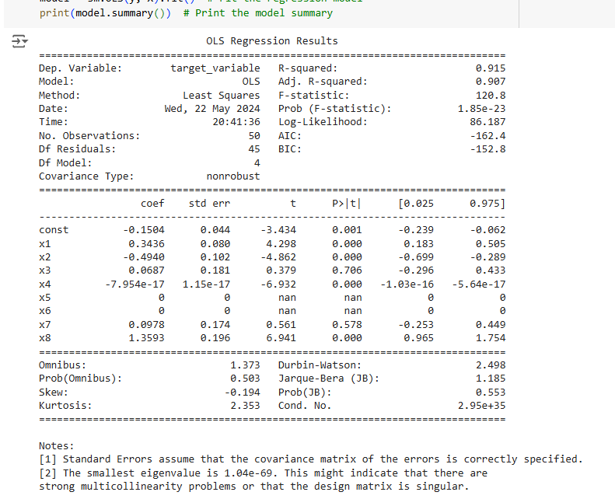
Regression Analysis

Slide 48
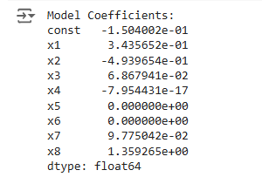
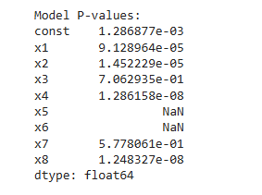
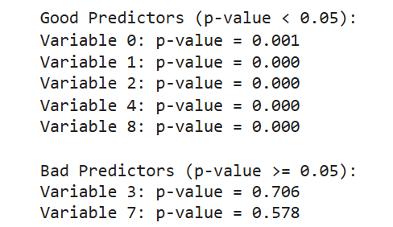
Regression Analysis

Slide 49
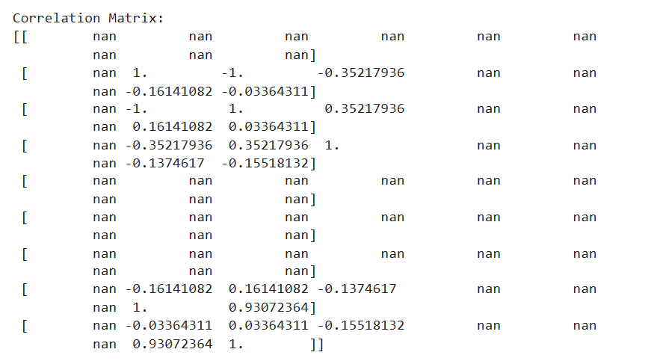
Regression Analysis

Slide 50
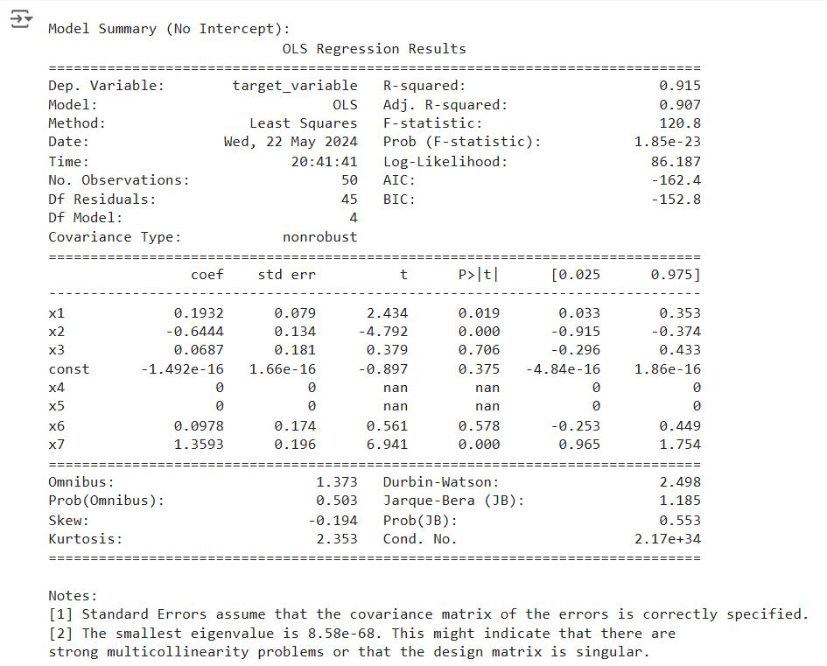
Regression Analysis

Slide 51
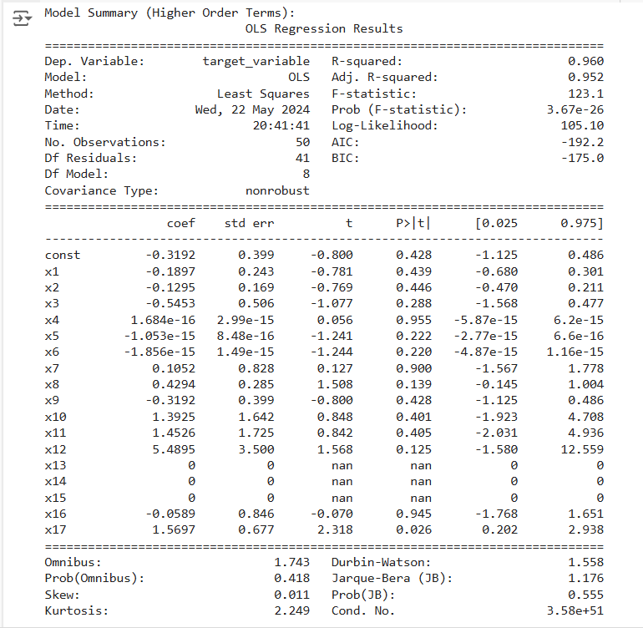
Regression Analysis

Slide 52
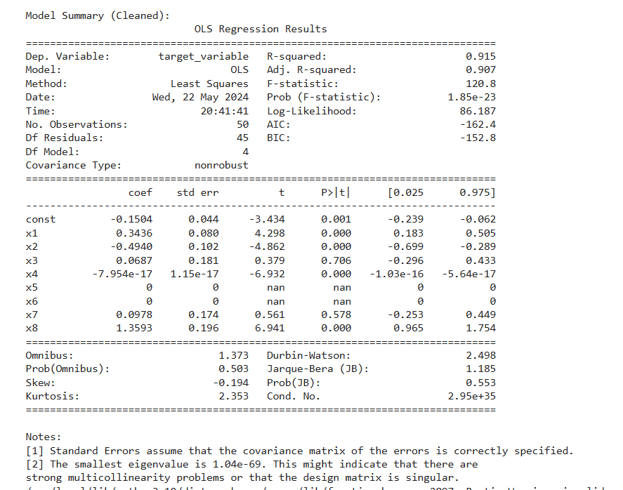
Regression Analysis

Slide 53
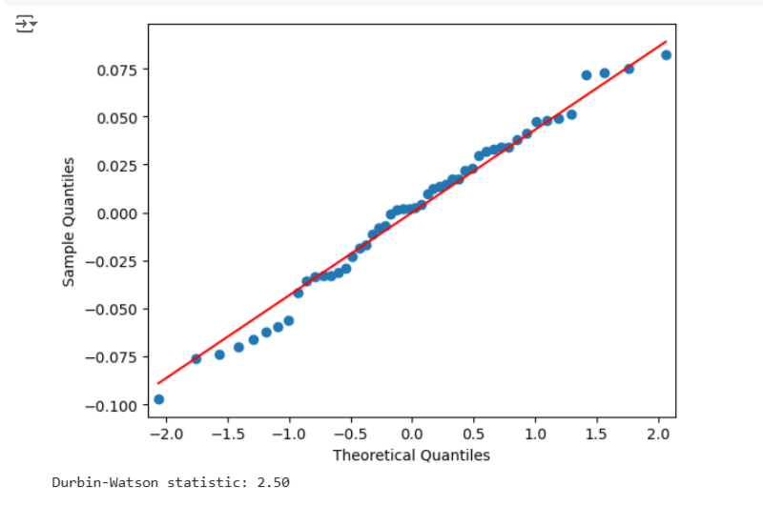
Regression Analysis

Slide 54
Regression Analysis
The last figure provides a test of our model’s performance in comparison to our predicted outcomes.

Slide 55
06
Machine Learning classifier

Slide 56
Data Preparation
Feature Selection
Model Training
Remove duplicates.
Filtering non-informative data.
Undersample the majority class to ensure balance.
Consider factors such:
Symptom status
Location
Gender
Race
Ethnicity
Hospitalization
ICU admission
Pre existing health conditions
Divide the data into training and testing groups with 80% allocated for training and 20 %,
for testing purposes.

Slide 57
Model Approach
Model Performance
We combined the steps with the
XGBoost classifier to create a workflow from the initial data to making predictions.
Accuracy: 0.98
Precision: 0.83
Recall: 0.42
F1-Score: 0.56
Course 40 Degree

Slide 58
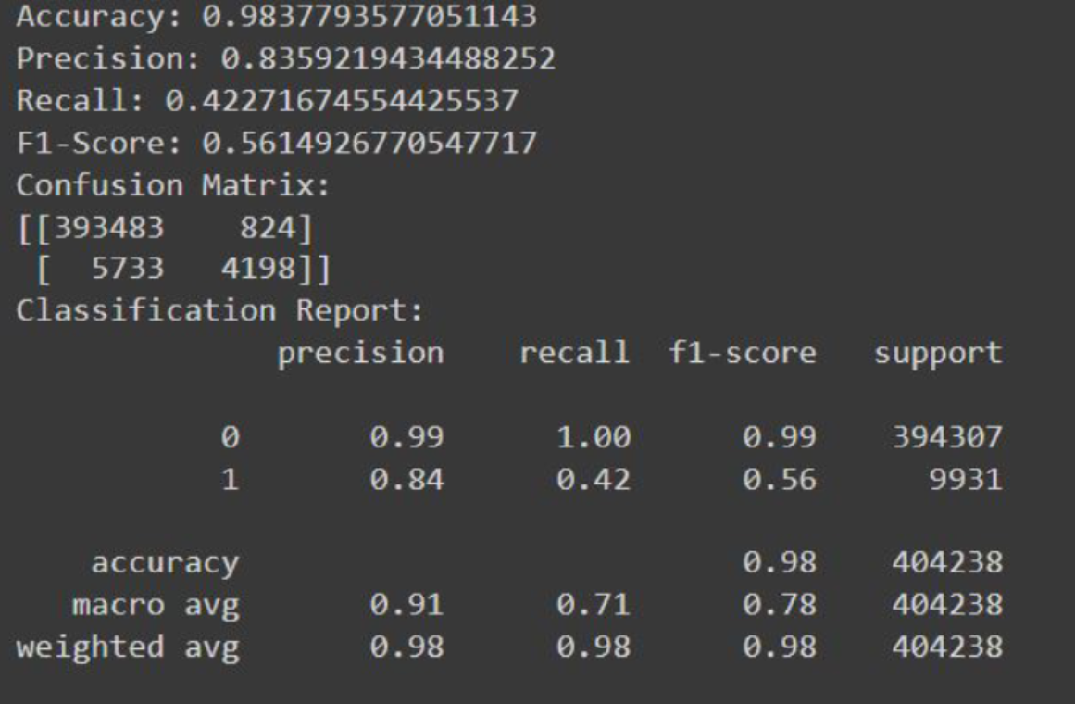
Model Performance

Slide 59
Conclusion

Slide 60
In conclusion, this in-depth analysis of COVID-19 data from the CDC and US Census Bureau has yielded valuable insights into the pandemic's impact across the United States. By identifying key trends and correlations between patient demographics and mortality risk, the study paves the way for more targeted public health interventions and resource allocation. The promise of machine learning models for predicting death risk offers a potentially powerful tool for healthcare professionals. However, acknowledging potential data biases and the ongoing nature of the pandemic is crucial for responsible interpretation. Continued monitoring and research will be essential to fully understand the long-term consequences of COVID-19. This study underscores the critical role of comprehensive data analysis in guiding evidence-based public health responses to future pandemics.

